Slide 1
Unit 1, Lesson 1
Powerful Ancestral Bonds
4.2 Million BCE – 35,000 BCE
Ch. 1 in textbook

Slide 2
All Life Came From The Ocean,
All Humans Came From Africa
It is important to understand that when we dig deep into our ancestor-tree, we are all Africans.
How did we get all around the globe?
Well, way back in 2 million BCE the globe became covered in a thick sheet of ice. We call this time period the Ice Age.
This thick sheet of ice allowed us to migrate to other continents.
Why do we all look different if we originate from the same place?
New climates were to thank for physical changes in different groups of humans.

Slide 3
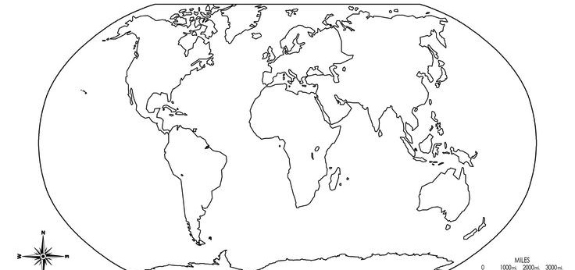

Slide 4
A Common Ancestry
As we began to spread out and grow in numbers, we maintained a common ancestry.
What does common ancestry mean?
Common ancestry is defined as a powerful bond between people who share the same origins.
This common ancestry has been tested by acts of injustice and inhumanity repeatedly throughout history.
Your text claims that the above goes hand in hand with human development. Do you believe that is true? Why or why not?

Slide 5
The Science
Scientists have been studying DNA to prove that all of our ancestors are from Africa. To do this, they compare DNA material from fossils found in Africa to DNA material taken from people in various parts of the world. Comparing these samples of DNA has proven that all humans are descended from one common female ancestor: scientists call her “Eve”.
What do “DNA” and “ancestors” mean?
Notes:
DNA – is the genetic code that carries information about cells and controls heredity.
Ancestors – somebody from whom someone else is directly descended, especially someone more distant than a grandparent.

Slide 6
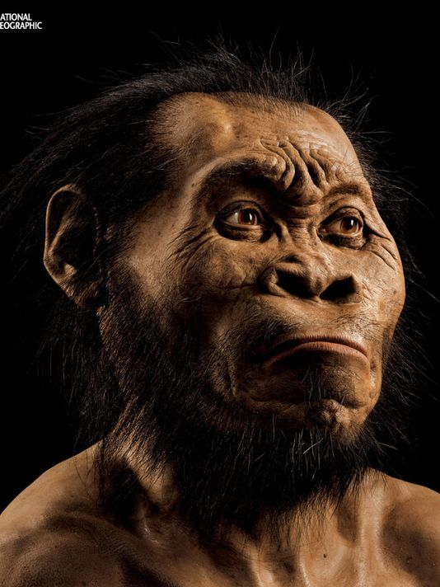
The Story of Eve
Eve was a small
muscular young
woman who lived in
Africa between
100,000 and 200,000
years ago.
This is what I think
she looks like:

Slide 7
Monogenesis
This finding supports the theory of monogenesis.
What do you think “monogenesis” means?
Monogenesis – one common origin.
Think of it like this:
Mono = One
Genesis = The origin or mode of formation of something.
There was this guy who categorized all living things, including us. We are homo sapiens, which is our genesis (the sapien part). For all canines, they have different first words, but for all different species they end in lupus.

Slide 8
The Cradle of the Human Race
The history of the human race goes back to a time before recorded history, a time known as prehistory.
During prehistory there existed small human-like creatures called hominids.
The first hominids to appear in Africa were called Australopithecines. The oldest of these guys is named ramidius, and there are only a few small bone fragments that document their existence.
There is a more popular one named afarensis, and he/she was discovered in 1974 by a team of Ethiopian archeologists.
Notes:
We are going to take a step back in time to before homo sapiens….when there were tiny little hominids running around.

Slide 9
The Cradle of the Human Race
Archeologists are scientists who study bone fragments and other human remains from past cultures.
Back to our hominid friend: you may better know of this little Australopithecine hominid as Lucy.
Lucy lived about 3.2 million years ago.
Her environment was probably rich in food, water, and natural places for shelter.

Slide 10
Checkpoint!
It’s time to take a 60 second break!
Get up and stretch, try to crack your back, whatever gets that blood flowing back to those still muscles!
At the end of the 60 seconds we will do a quick review.

Slide 11
Vocab – Common Ancestry

Slide 12
Vocab – Ancestors

Slide 13
Vocab – Archaeologists

Slide 14
Vocab – DNA

Slide 15
Vocab – Monogenesis

Slide 16
Vocab – Prehistory

Slide 17
Vocab – Hominids

Slide 18
Questions
Can you remember the year the first human-like species appeared?
Hint: it was on the title slide!
The Answer: 4.2 Million BCE
When was the Ice Age?
The Answer: 2 Million BCE
Who is Lucy? Why is she important?
The Answer: She is the oldest and most complete skeleton of the Australopithecines and a major link to learning about our history.

Slide 19
DO NOW:
Read this quote and tell me how it relates to what
we are learning. Then, tell me your thoughts about
it. Lastly, what do you think of the language used?
“It is a heart quickening thought
that we shared the same heritage
with the hand that shaped the tool
that we can now hold in our own
hands, and with the mind that
decided to make the tool that our
minds can now contemplate.”

Slide 20
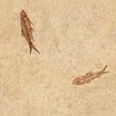
Say a big
hello to
Lucy!

Slide 21
The First Human Migration
The first human migrations began in Africa as small groups of people began to move around from place to place.
As they developed, some began to move outside Africa’s borders to new lands in the unpopulated regions of Europe and Asia.
Others migrated throughout Africa, leaving behind a trail of tools and other artifacts that offer clues to their existence.
What are artifacts?
An artifact is an object made by a human being, for example, a tool or ornament, especially one that has archeological or cultural interest.

Slide 22
Richard Leaky
Richard Leaky is a Kenyan archeologist.
In 1972 he discovered a stone tool left by a hunter and toolmaker 3 million years ago by Lake Turkana in East Africa.
After examining it, Leaking remarked:
“It is a heart quickening thought that we share the same heritage with the hand that shaped the tool that we can now hold in our own hands, and with the mind that decided to make the tool that our minds can now contemplate.”
Notes:
Did your understanding of this quote change now that you know its origin?
Using what you know now, how does this quote relate to what we are learning?
What are your thoughts on this quote?
What do you think of the language of this quote now?
This quote = the unbroken connection between the past and the present.

Slide 23
History as a Continuation
Just like our ancestors left us evidence of their
existence, we will leave behind the evidence
of our civilization.
What does “civilization” mean?
Civilization – our system of social development.

Slide 24
Human Ancestors

Slide 25
This large map shows the directions of human migration.
The insert map shows the location in Africa where fossils of human ancestors have been found.
In which two modern countries were the most Australopithecus Afarensis fossils found?
Where were Australopithecus Africanus fossils concentrated?

Slide 26
The Start of Civilization
Civilization started in the great river valleys of Africa and Asia, in the Fertile Crescent in the Near East and along the narrow ribbon of the Nile in Africa.
In the Nile Valley that beginning was an African as well as an Asian achievement, for they were among the first people to use tools, paint pictures plant seeds, and worship gods.

Slide 27
The Start of Civilization
For a long time, in fact, the only people on the scene were Africans.
For some 600,000 years Africa and the Africans led the world.
Were these the people who gave the world fire and tools and cultivated grain – were they [of dark skin]?
It is probable that these people were indeed dark-skinned.

Slide 28
Next:
We are going to
look at a few
important locations
Where major discoveries
Were made

Slide 29
Olduvai George
A series of astonishing discoveries in this Tanzanian canyon suggest that the most important an fascinating developments in human history occurred in Africa.
Discoveries by Dr. Leslie Leakey (Richard Leakey’s dad) and other archeologists indicate that the human race was born in Africa.
A growing body of research from this and other African sites indicates further that tool-making began in Africa and that this seminal invention spread to Europe and Asia.

Slide 30
The Nile Valley
Important finds in the Sudan and the Nile Valley prove that people of a [African] type were influential contributors to that cradle of civilization – ancient Egypt.
Discoveries at excavations near Khartoum in the Sudan and at El Badari on the Nile indicate that Stone Age [Africans] laid the foundation for much of the civilization of the Nile Valley and manufactured pottery before pottery was made in the world’s earliest known city.

Slide 31
Central and South America
American and African-American scholars, working primarily in the United States and Mexico, unearth new archeological evidence, including carbon 14-dated sculpture, which suggests that African mariners explored the New World before Columbus.
This evidence and corroborative data from the diaries and letters of explorers, Arabic charts and maps and the recorded tales of African griots indicate that there was extensive pre-Columbian contact between ancient Africa and the Americas.
Notes:
Griot = a member of a class of traveling poets, musicians, and storytellers who maintain a tradition of oral history in parts of West Africa.

Slide 32
The Sahara
French explorer Henri Lhote discovers rock paintings which suggest to author Basil Davidson that “peoples of [African] type were painting men and women with a beautiful and sensitive realism before 3000 BC and were, perhaps, the originators of naturalistic human portraiture.”

